Slide 1
THIẾT KẾ VÀ CÀI ĐẶT MẠNG
Ths. Nguyễn Huỳnh Huy
Khoa: CNTT – ĐH Nha Trang
Email: huynh@ntu.edu.vn
SĐT: 077.2567899

Slide 2
Chapter Three
Characterizing the Existing Internetwork

Slide 3

What’s the Starting Point?
According to Abraham Lincoln:
  “If we could first know where we are and whither we are tending, we could better judge what to do and how to do it.”

Slide 4
Where Are We?
Characterize the existing internetwork in terms of:
  Its infrastructure
    Logical structure (modularity, hierarchy, topology)
    Physical structure
  Addressing and naming
  Wiring and media
  Architectural and environmental constraints
  Health

Slide 5





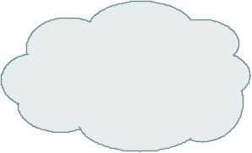
Get a Network Map
Medford
Fast Ethernet
50 users
Roseburg
Fast Ethernet
30 users
Frame Relay
CIR = 56 Kbps
DLCI = 5
Frame Relay
CIR = 56 Kbps
DLCI = 4
Gigabit Ethernet
Grants Pass
HQ
Gigabit Ethernet
Grants Pass
HQ
Fast Ethernet
75 users
FEP
(Front End Processor)
IBM
Mainframe
T1
Web/FTP server
Eugene
Ethernet
20 users
T1
Internet

Slide 6
Characterize Addressing and Naming
IP addressing for major devices, client networks, server networks, and so on
Any addressing oddities, such as discontiguous subnets?
Any strategies for addressing and naming?
  For example, sites may be named using airport codes
    San Francisco = SFO, Oakland = OAK

Slide 7


Discontiguous Subnets
Area 0
Network 192.168.49.0
Router A
Router B
Area 1
Subnets 10.108.16.0 - 10.108.31.0
Area 2
Subnets 10.108.32.0 - 10.108.47.0

Slide 8
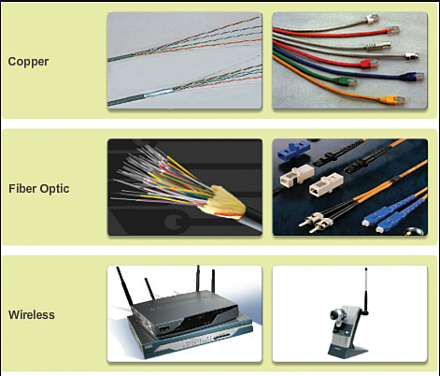
Characterize the Wiring and Media
Single-mode fiber
Multi-mode fiber
Shielded twisted pair (STP) copper
Unshielded-twisted-pair (UTP) copper
Coaxial cable
Microwave
Laser
Radio
Infra-red

Slide 9

Campus Network Wiring
Horizontal
Wiring
Work-Area
Wiring
Wallplate
Telecommunications
Wiring Closet
Vertical
Wiring
(Building
Backbone)
Main Cross-Connect Room
(or Main Distribution Frame)
Intermediate Cross-Connect Room
(or Intermediate Distribution Frame)
Building A - Headquarters
Campus
Backbone
Building B

Slide 10
Architectural Constraints
Make sure the following are sufficient
  Air conditioning
  Heating
  Ventilation
  Power
  Protection from electromagnetic interference
  Doors that can lock

Slide 11
Architectural Constraints
Make sure there’s space for:
  Cabling conduits
  Patch panels
  Equipment racks
  Work areas for technicians installing and troubleshooting equipment

Slide 12
Issues for Wireless Installations
Reflection
Absorption
Refraction
Diffraction
Notes:
Reflection. Reflection causes the signal to bounce back on itself. The signal can interfere with itself in the air and affect the receiver’s ability to discriminate between the signal and noise in the environment. Reflection is caused by metal surfaces such as steel girders, scaffolding, shelving units, steel pillars, and metal doors. Implementing a Wireless LAN (WLAN) across a parking lot can be tricky because of metal cars that come and go.
Absorption. Some of the electromagnetic energy of the signal can be absorbed by the material in objects through which it passes, resulting in a reduced signal level. Water has significant absorption properties, and objects such as trees or thick wooden structures can have a high water content. Implementing a WLAN in a coffee shop can be tricky if there are large canisters of liquid coffee. Coffee-shop WLAN users have also noticed that people coming and going can affect the signal level. (On StarTrek, a non-human character once called a human “an ugly giant bag of mostly water”!)
Refraction. When an RF signal passes from a medium with one density into a medium with another density, the signal can be bent, much like light passing through a prism. The signal changes direction and may interfere with the non-refracted signal. It can take a different path and encounter other, unexpected obstructions, and arrive at recipients damaged or later than expected. As an example, a water tank not only introduces absorption, but the difference in density between the atmosphere and the water can bend the RF signal.
Diffraction. Diffraction, which is similar to refraction, results when a region through which the RF signal can pass easily is adjacent to a region in which reflective obstructions exist. Like refraction, the RF signal is bent around the edge of the diffractive region and can then interfere with that part of the RF signal that is not bent.

Slide 13
Check the Health of the Existing Internetwork
Performance
Availability
Bandwidth utilization
Accuracy
Efficiency
Response time
Status of major routers, switches, and firewalls

Slide 14
Check the Status of Major Routers, Switches, and Firewalls
show buffers
show environment
show interfaces
show memory
show processes
show running-config
show version

Slide 15
Tools
Protocol analyzers
Multi Router Traffic Grapher (MRTG)
Remote monitoring (RMON) probes
Cisco Discovery Protocol (CDP)
Cisco IOS NetFlow technology
CiscoWorks

Slide 16
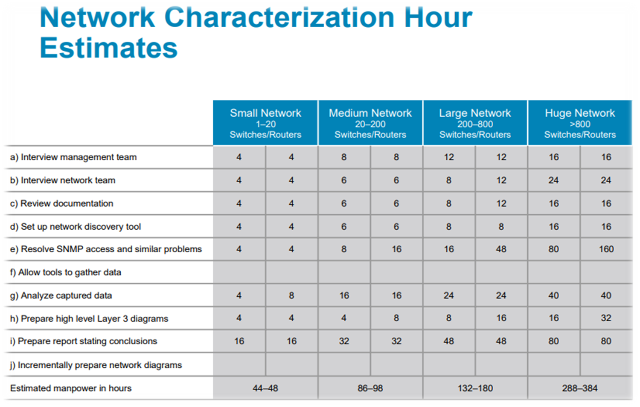

Slide 17
Summary
Characterize the existing internetwork before designing enhancements
Helps you verify that a customer’s design goals are realistic
Helps you locate where new equipment will go
Helps you cover yourself if the new network has problems due to unresolved problems in the old network

Slide 18
Review Questions
What factors will help you decide if the existing internetwork is in good enough shape to support new enhancements?
When considering protocol behavior, what is the difference between relative network utilization and absolute network utilization?
Why should you characterize the logical structure of an internetwork and not just the physical structure?
What architectural and environmental factors should you consider for a new wireless installation?

Slide 19
Q&A

